Slide 1
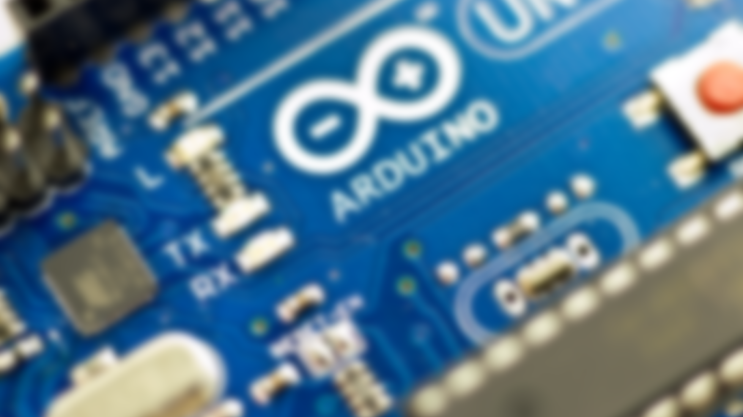


NIT ConclaveX – Genesis ‘22
Introduction to Arduino
By, Robotics and Machine Intelligence (RMI)

Slide 2
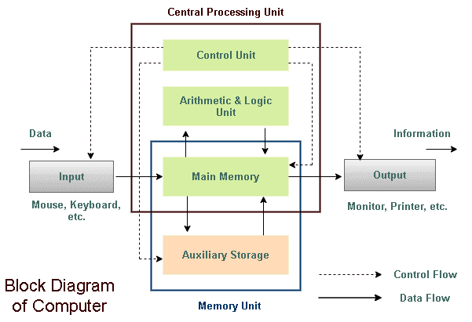
Block Diagram of a Computer

Slide 3
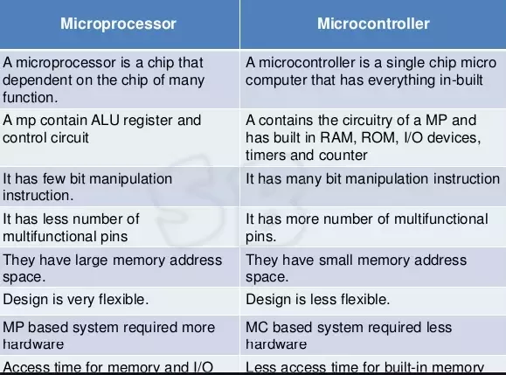
Microprocessors and Microcontrollers

Slide 4
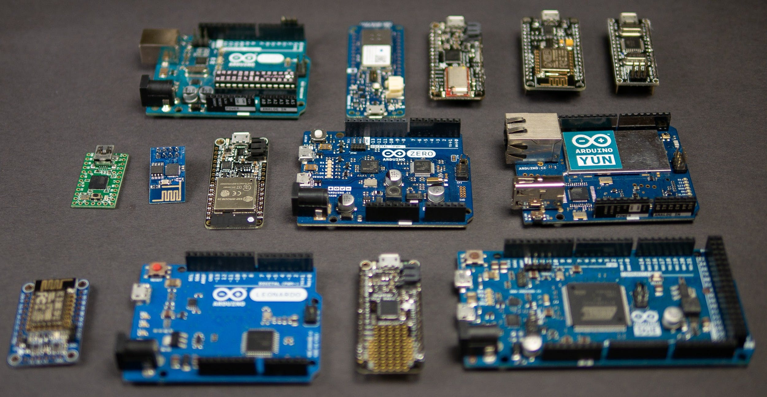

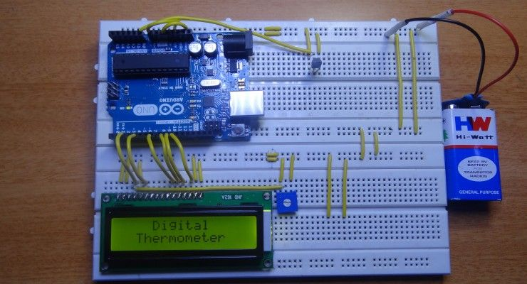
What is an Arduino?
Arduino is an open-source hardware and software company, project, and user community that designs and manufactures single-board microcontrollers and microcontroller kits for building digital devices.
We generally call even the boards as Arduinos.
There are different forms of Arduino boards, some of the most common ones are as follows:
Arduino UNO
Arduino Leonardo
Arduino Mega
Arduino Micro
Arduino Nano

Slide 5

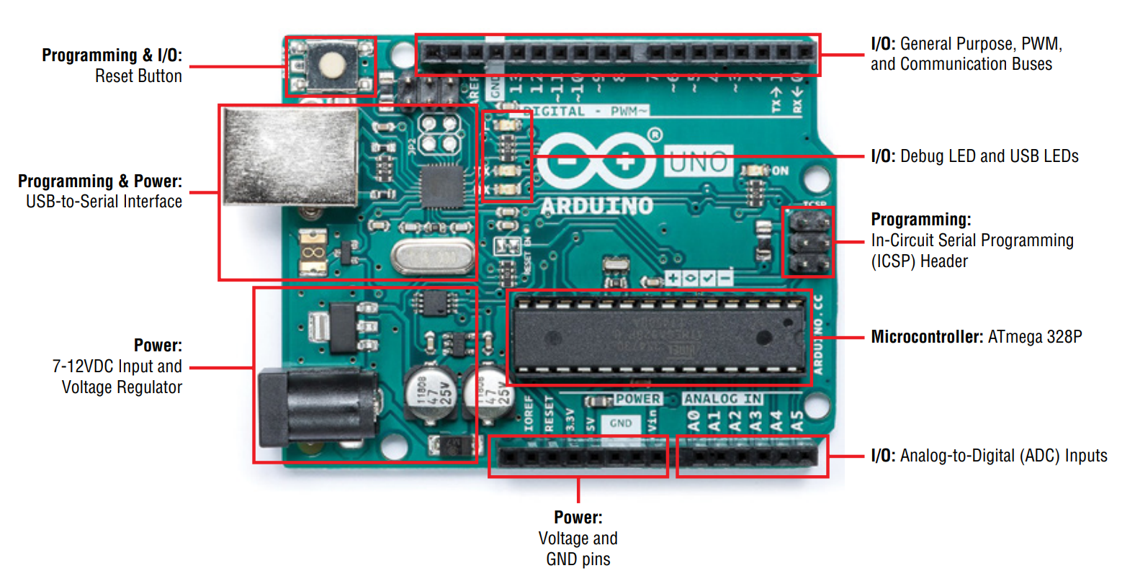
Components in an Arduino UNO

Slide 6
Digital GPIO Pins
General Purpose Input Output (GPIO) pins are used as input or output for interfacing devices.
Configuration:
Input to read switch’s state, sensor data, etc.
Output to control the LED brightness, motor rotation, show text on display, etc.
Just 3 functions:
A. pinMode(pin, Mode): This function is used to configure GPIO pin as input or output.
B. digitalRead(pin): It is used to read data from specified GPIO pin
C. digitalWrite(pin, Output value): This function is used to set output as HIGH (5 V) or LOW (0 V)

Slide 7
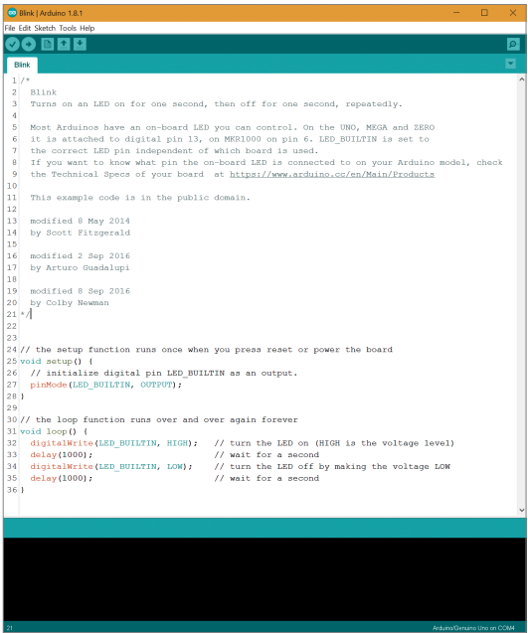
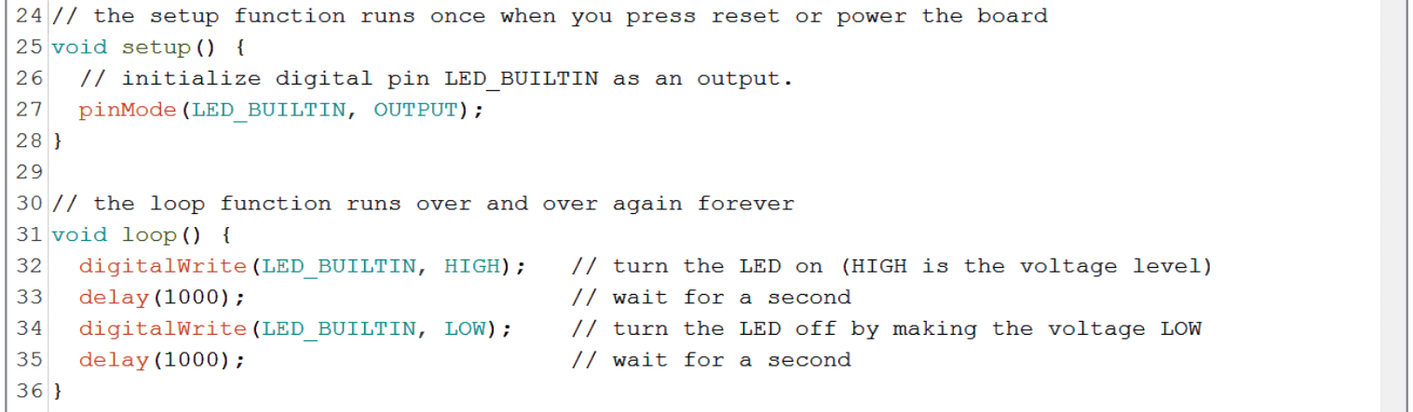
Creating your first program!
The Arduino programming language is almost similar to C++
setup( ) function runs only once after the board is powered up or when the reset button is pressed.
loop( ) function runs over and over again forever.
Let’s Tinker: https://www.tinkercad.com/things/0UAbYpk0PUp-in-built-led-blink-example-/editel?sharecode=Rnfcof9SiimtQJmqTb0Q95Caix_NHsTcbAVp0faj1UU
Notes:
Fun task: LED blinking morse code to say “Hello World”

Slide 8
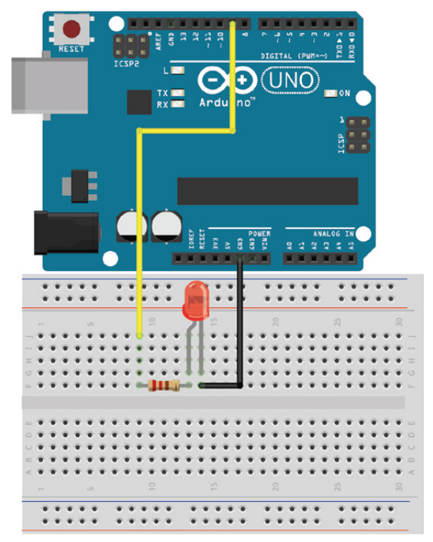
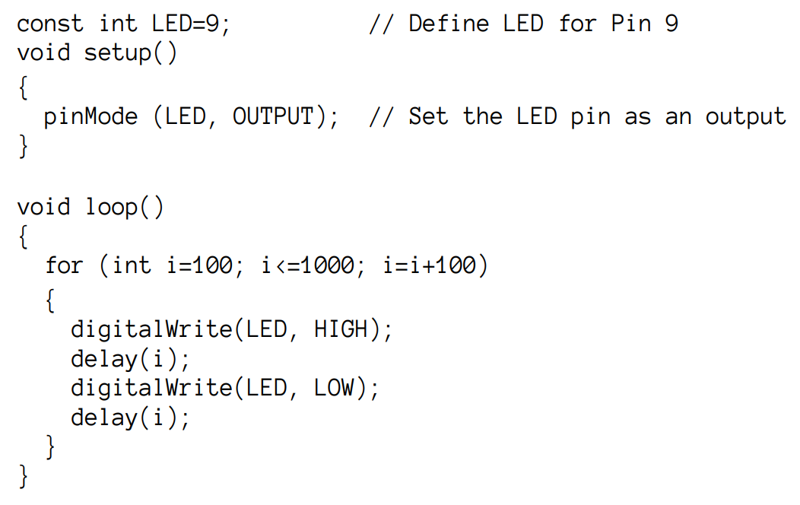
Wiring up an External LED
Let’s Tinker: https://www.tinkercad.com/things/d2ba0jInRz2
Notes:
This will demonstrate the need for resistors in using LEDs, how to use breadboards, wiring tips in real life

Slide 9
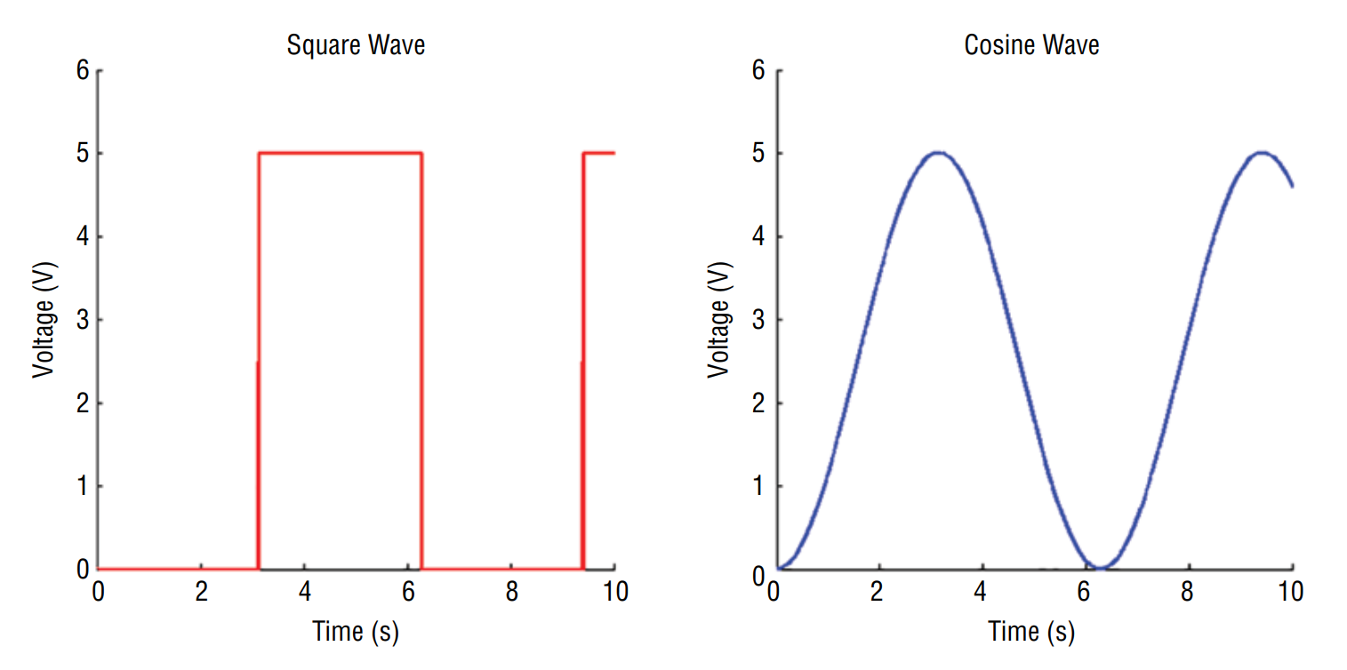
Digital and Analog Signals

Slide 10
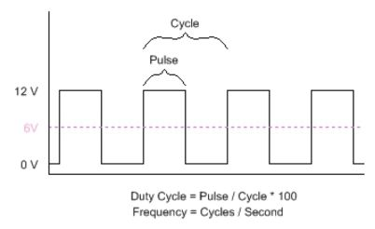

Pulse Width Modulation (PWM)
It is a technique to get analog output with digital means as microcontroller can give only digital signals as output.
The width of a pulse is varied while keeping the frequency of the wave constant to get an analog signal.
A PWM signal consists of two main components that define its behavior: a duty cycle and a frequency.
Notes:
Real life examples like computer monitor brightness adjustment, LED brightness demonstration (fade in fade out)

Slide 11
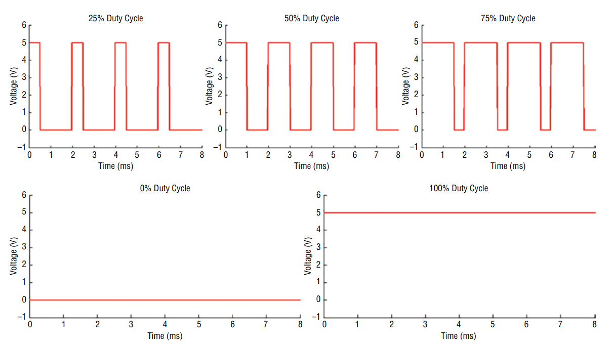
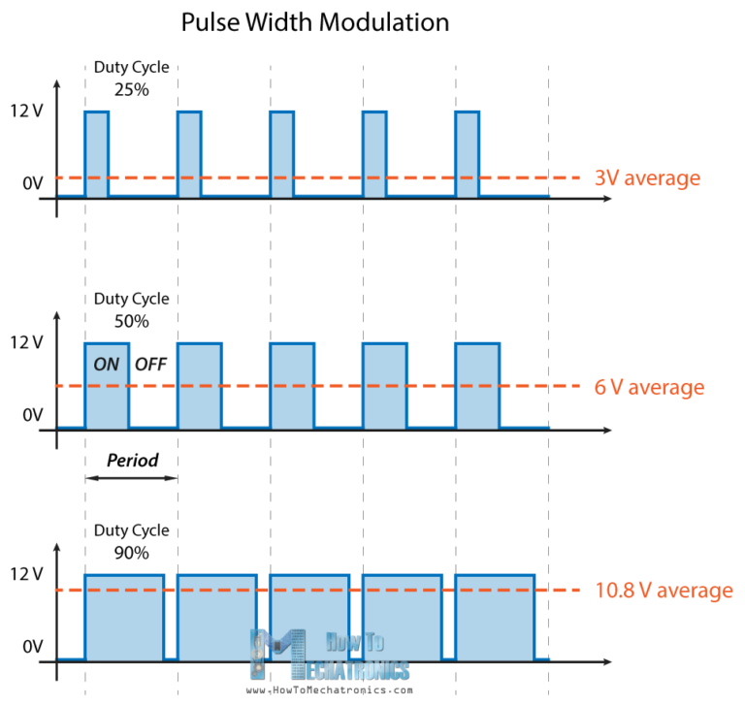
Pulse Width Modulation (PWM)
V(t) = 12|Sin(t)|

Slide 12
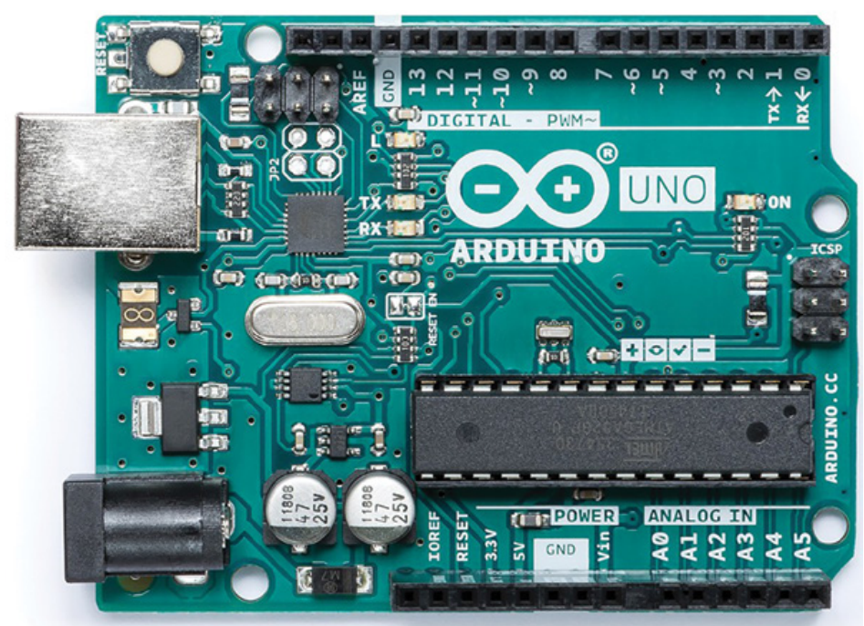
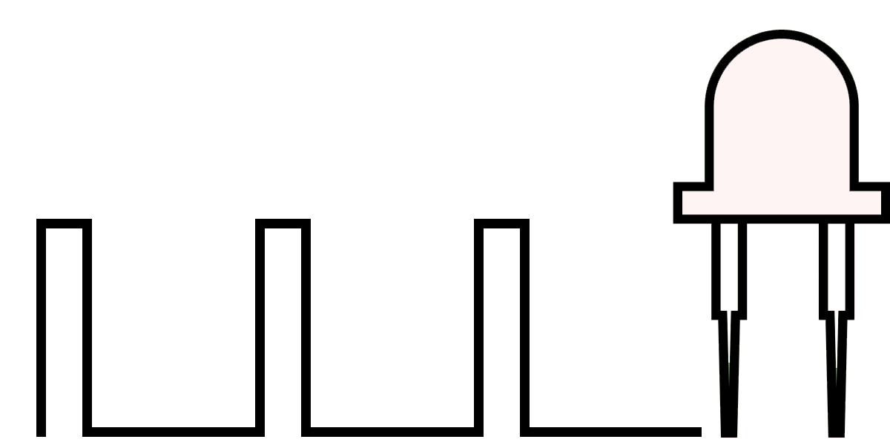
Pulse Width Modulation (PWM)
analogWrite(pin,val);
pin = output pin number
(3,5,6,9,10,11)
val = duty cycle * 255
Tinker Time! https://www.tinkercad.com/things/036JrGmW2Kf

Slide 13
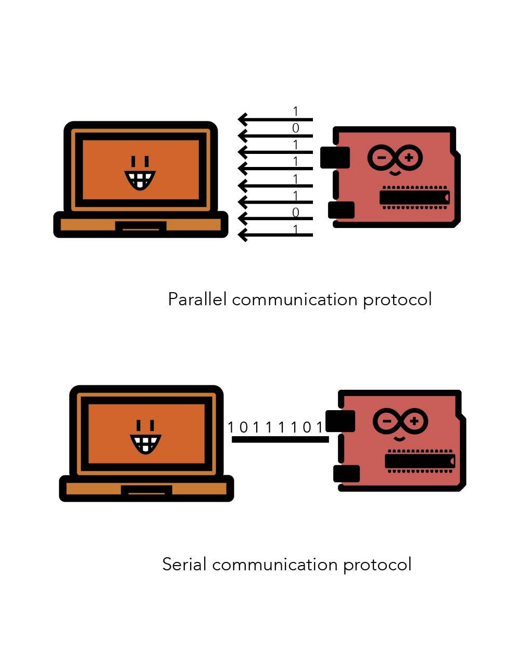
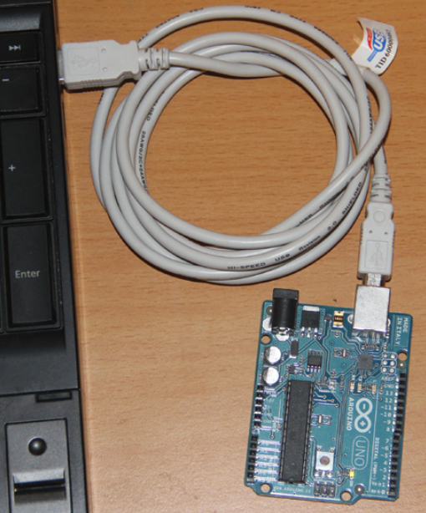
Serial and Parallel Communication
For 2 devices to communicate serially,
Digital Pulses sent back and forth between devices must agree on a rate as each device has a different .
‘Sender’ sends pulses that represent data while receiver receives it.
Notes:
Explain serial communications,

Slide 14
Serial Communication Functions
a) Serial.begin(baud_rate)
baud_rate : The baud rate that will be used for serial communication. Can be 4800, 9600, 14400, 19200, etc.
This function is used to define the baud rate that will be used for serial communication.
For communicating with specific devices, the device baud rate needs to be used.
Example: Serial.begin(9600) defines 9600 baud rate for communication.
b) Serial.available()
This function is used to get the number of bytes available for reading from the serial port.
It gives the number of bytes of data that has arrived and is stored in the serial receive buffer.
Example: if(Serial.available()) If data available at serial port, take action.

Slide 15
Serial Communication Functions
c) Serial.print(value)
value : character, string, number to be printed.
This function is used to print data to a serial port in a form that is human readable (character, strings, numbers).
Example Serial.print(“Hi 1234”) Prints Hi 1234 on the serial monitor.
d) Serial.println(value)
value : character, string, number to be printed.
This function is used to print data to a serial port in a form that is human readable (character, strings, numbers) followed by a carriage return (\r) and a new line character (\n).

Slide 16
Serial Communication Functions
e) Serial.read()
This function returns a character that was received on the Rx pin of Arduino.
Example : char read_byte read_byte = Serial.read() Byte of data read is stored in read_byte.
f) Serial.write(value), Serial.write(string), Serial.write(buff, length)
value : value to be sent as a single byte.
string : string to be sent as a series of bytes.
buff : array of data to be sent as bytes.
length : number of bytes to be sent.
This function writes data in binary form to the serial port. Data is sent in form of bytes or series of bytes.
Example : Serial.write(100), Serial.write(“Hello”)

Slide 17
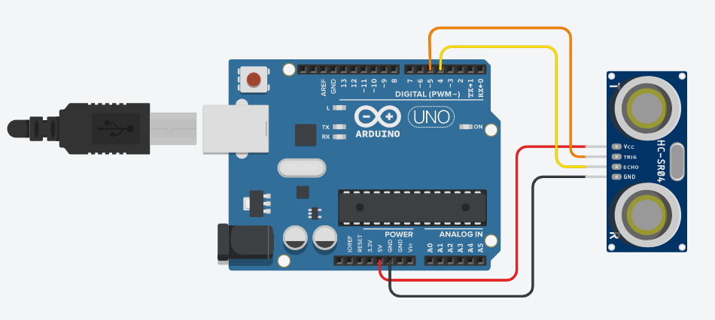
Serial Communication – Ultrasonic Sensor
https://www.tinkercad.com/things/gflLudkC9zF

Slide 18
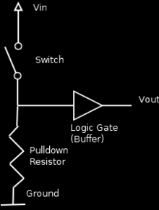
Pull-Down Resistors
Pull-down resistors are used in electronic logic circuits to ensure that input settles at logic-0, if external input is disconnected.
A floating pin picks up noise and interference from the nearby pins. The pull-down resistor dissipates the noises and maintains the potential of the input pin to zero volts (logic-0).

Slide 19
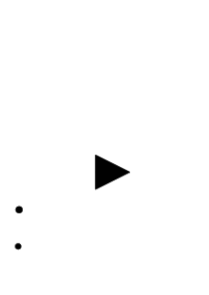
Pull-Up Resistors
Pull-up resistors are used in electronic logic circuits to ensure that input settles at logic-HIGH if external input is disconnected.
Just because you have nothing at all connected to an input pin doesn't mean it is at zero volts. It means the input pin is floating somewhere between low and high.

Slide 20
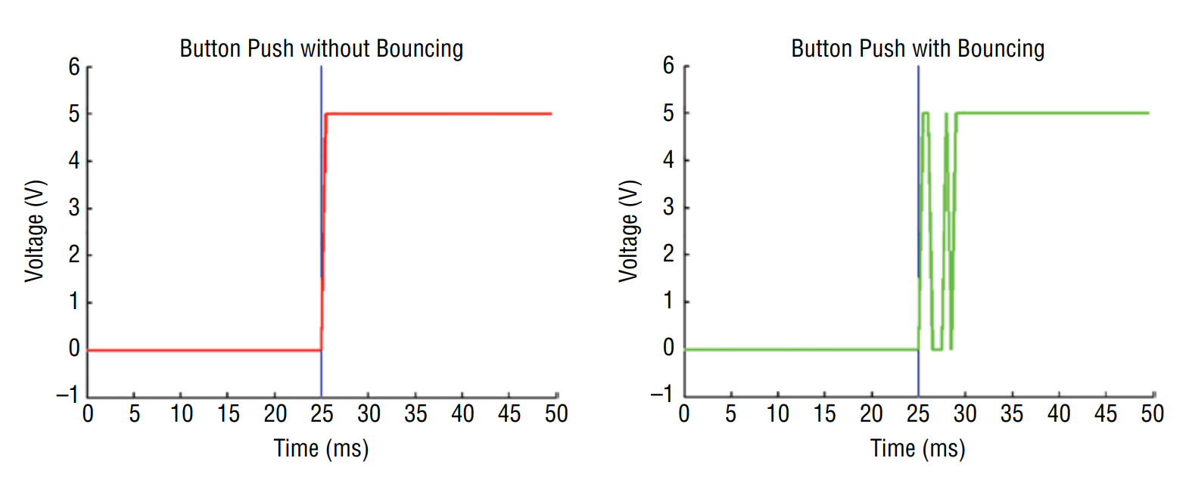
Reading a Button
Press and hold a button switch.
Expectation
Reality
So, we need to filter the jittering part out. This is achieved by following an algorithm called debouncing.

Slide 21
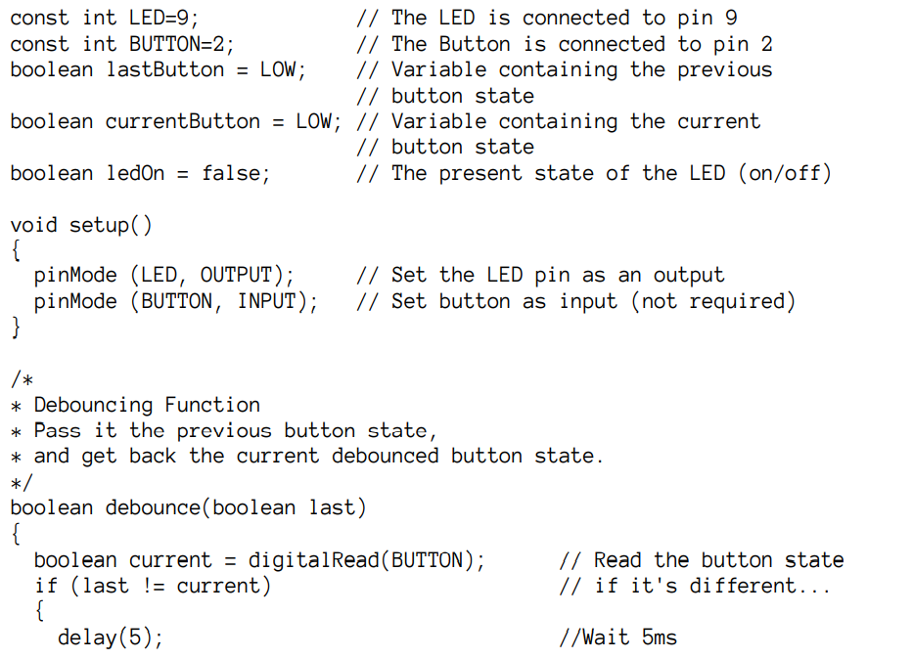
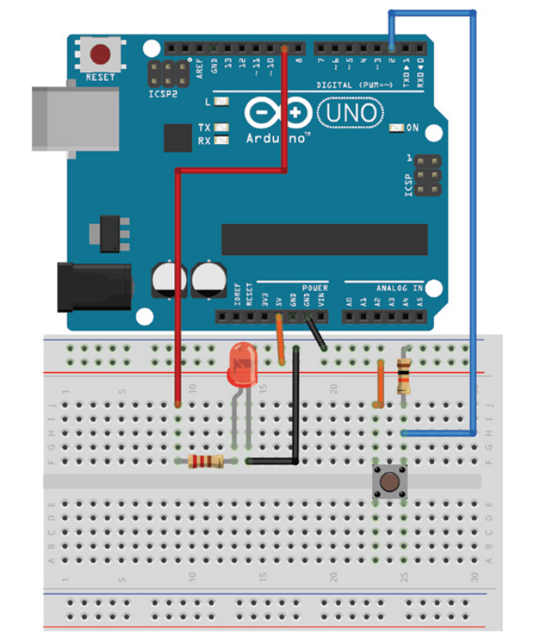
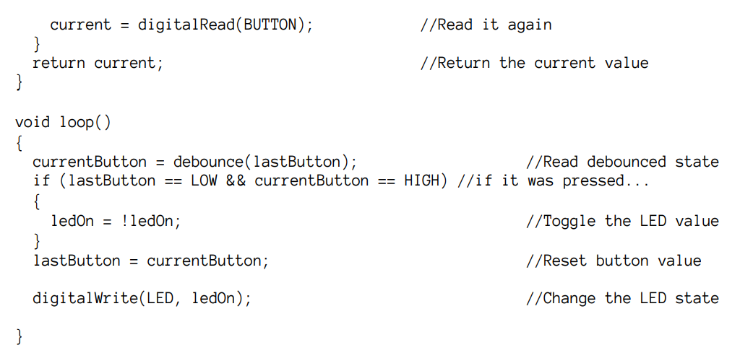
Debouncing a Button
TinkerCad Circuit: https://www.tinkercad.com/things/0w97JzYOQ7a

Slide 22
Reading Analog Inputs
Real world is dominated by analog quantities. So, for designing a real life project, we need to get analog inputs and give analog outputs at one point or another, but Computers & Microcontrollers can understand digital signals alone. So, we will be using methods like PWM & ADC to give analog output & analog input to the microcontroller

Slide 23
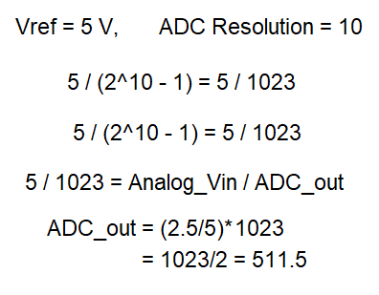
Analog to Digital Converters (ADCs)
Used for converting analog signals to digital signals.
Arduino Uno has 6 0n-board ADC channels which can be used to read analog signal in the range 0-5V.
It has 10-bit ADC means it will give digital value in the range of 0 – 1023 (2^10).
This is called as resolution which indicates the number of discrete values it can produce over the range of analog values.
Digital Output value Calculation:
ADC Resolution = Vref / ((2^n) - 1)
Digital Output = Vin/Resolution = (Vin/Vref)*(2^n-1)
out = digital value * (Vref/2^n – 1)

Slide 24
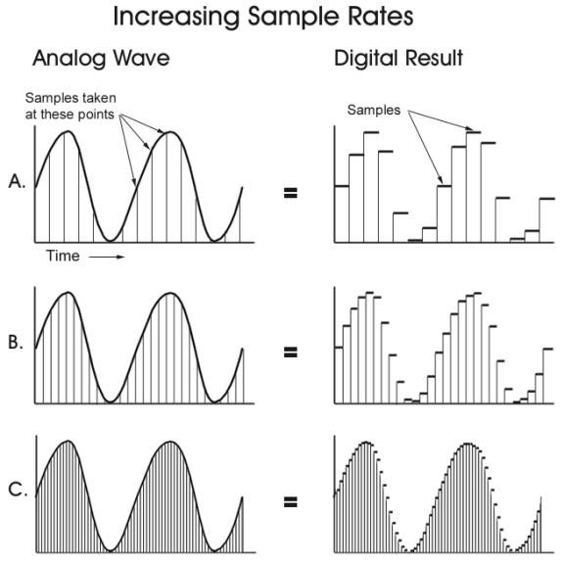
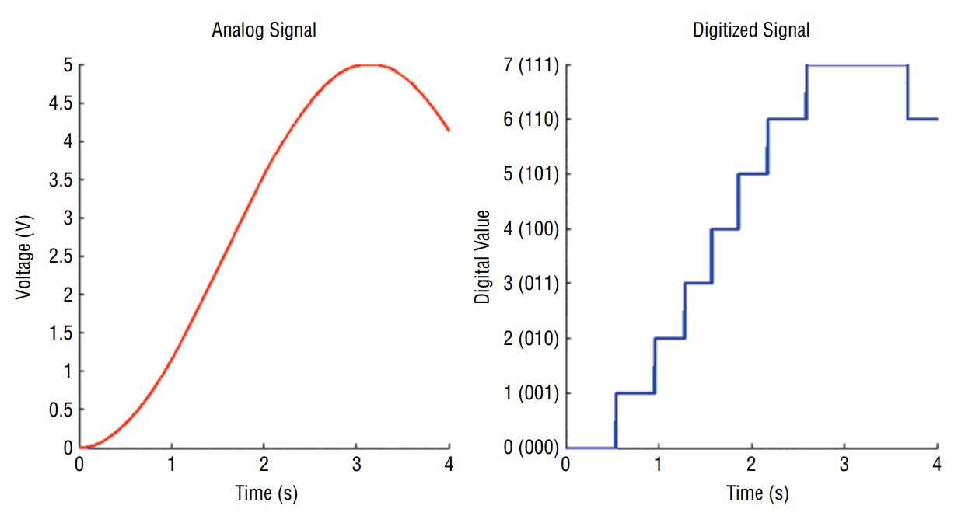
Analog to Digital Converters (ADCs)

Slide 25
ADC Functions
analogRead (pin)
This function is used to read analog value from specified analog pin.
pin - number of analog pin which we want to read
returns - digital value 0 – 1023
e.g. analogRead(A0) //read analog value at A0 channel
analogReference (type)
This function is used for configuring the reference voltage used for analog input.

Slide 26
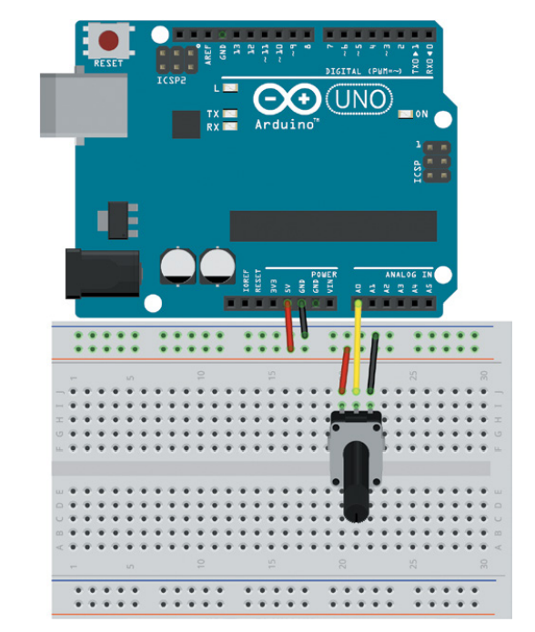
Reading a Potentiometer
Tinkercad Circuit to read a potentiometer and print the analog values in the Serial Monitor: https://www.tinkercad.com/things/3c9cS88QSe9-reading-a-potentiometer

Slide 27
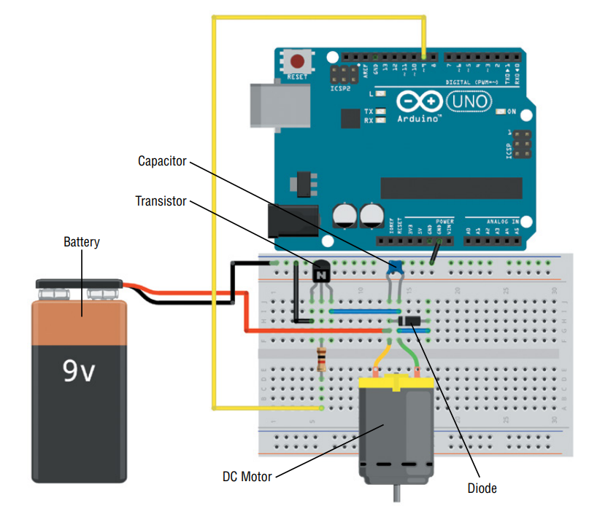
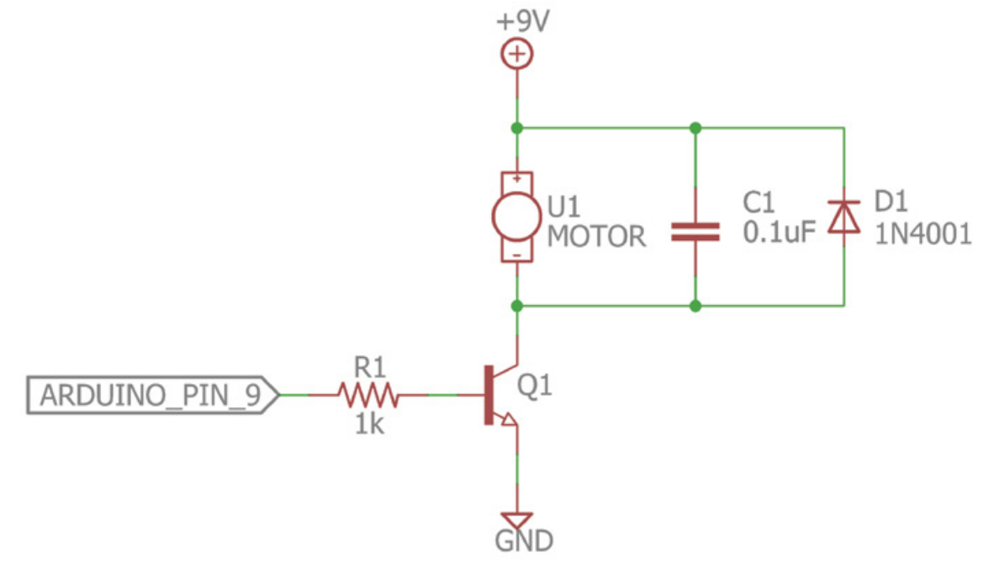
Controlling DC Motor

Slide 28
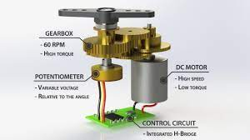

Servo Motor
Controlled by an electrical pulse of variable width, or pulse width modulation (PWM).
A servo motor can usually only turn 90° in either direction for a total of 180° movement.
Neutral position is defined as the position where the servo has the same amount of potential rotation in the both the clockwise or counter-clockwise direction.
Closed loop controller

Slide 29
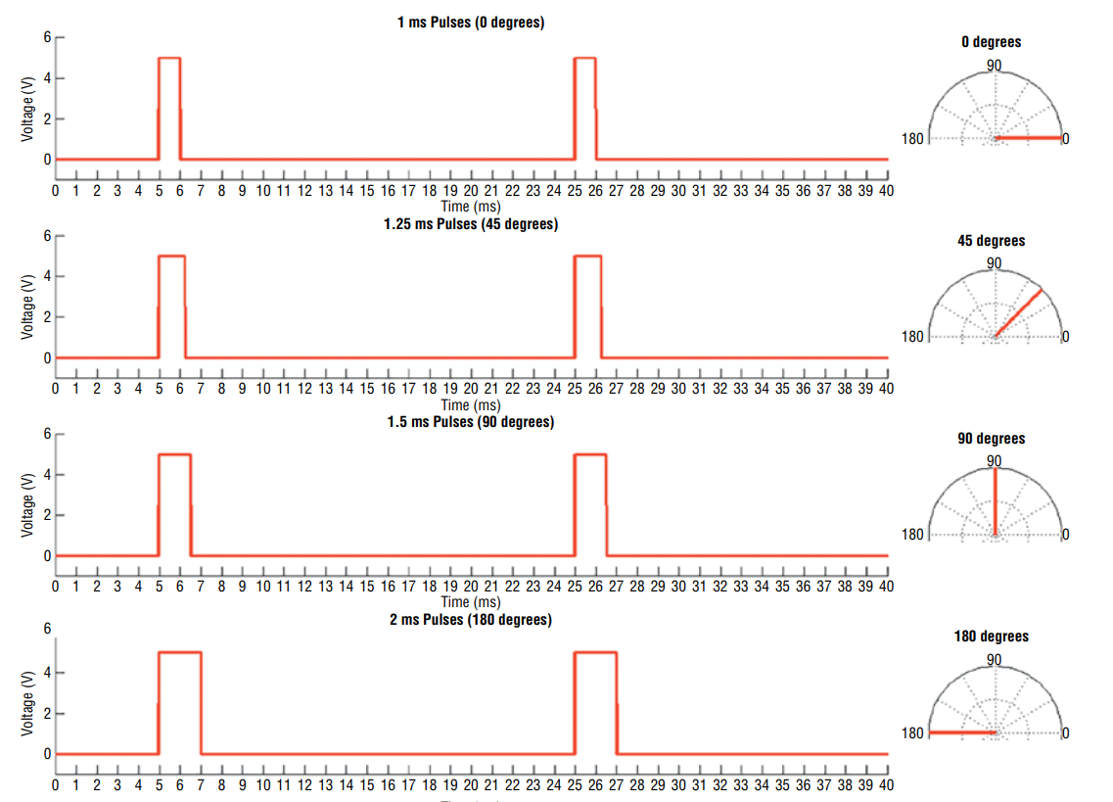
Servo Motor Timing Diagram

Slide 30
Using Libraries
Libraries help simplify your code.
For example, you don’t need to worry about the different timing diagrams for controlling a servo motor. By just using the Arduino servo library, you can just command the servo motor to take the desired angle.
The same goes for various other sensors and protocols which you will come across in future.

Slide 31
Fun Time with Servos!
Let’s see how a servo motor can be controlled using an Arduino: https://www.tinkercad.com/things/cYjORPV0auX
Next, let’s try to take analog input from a potentiometer and actuate the servo motor accordingly: https://www.tinkercad.com/things/cwDM79BGNeV

Slide 32
Polling and Interrupts
Polling:
The microcontroller continuously checks for the particular event at regular time intervals and carry out the special responses if it detects the event.
Interrupts:
An Interrupt is signal from microcontroller which makes microcontroller to temporarily stop what it is doing(normal routine) to handle another task.
Currently executing program is paused and another set of code or routine called ISR (interrupt service routine) is executed,after its execution the program resumes.

Slide 33
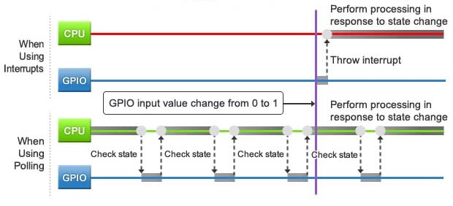
Polling and Interrupts

Slide 34
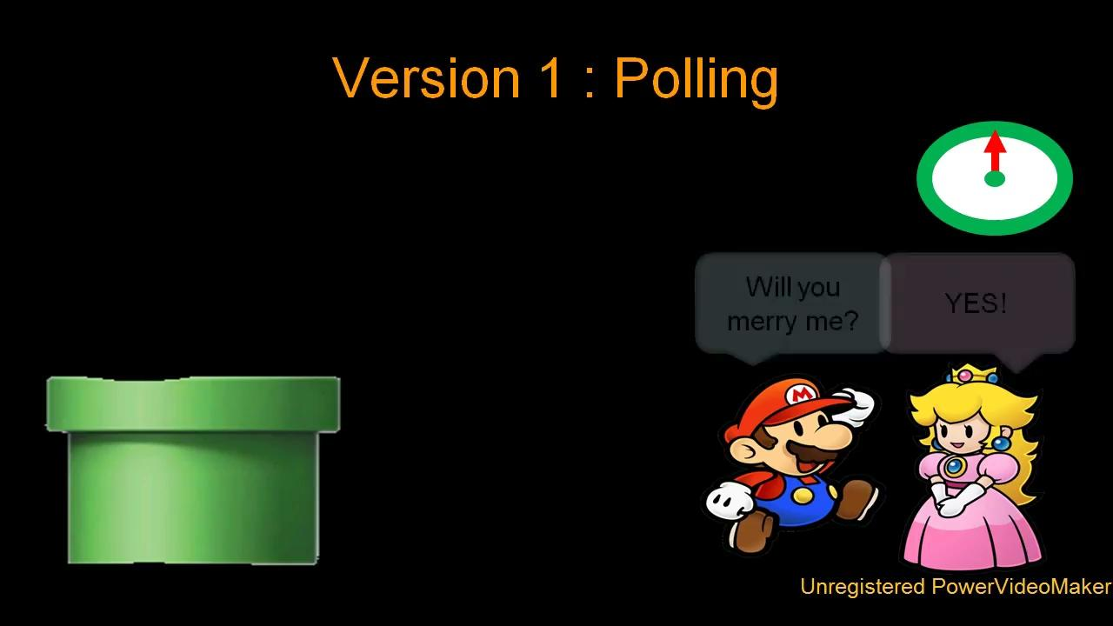
Visual Interpretation
Be like Mario using interrupt, be efficient!

Slide 35
Example program using buttons with polling:
https://www.tinkercad.com/things/4WaM2TXLJfg
Quick question:
In the above case there is a probability that the LED does not turn ON. Can you come with a reason?

Slide 36
When you have pressed the button the microcontroller might have been doing some other work (printing “Yo what’s up“ in the previous code) in its normal routine, hence it might not have noticed.
So the main drawback of Polling is loss of data. Another example if the microcontroller waits for a data every 2 seconds once and if the data arrives at 3 seconds then the data is lost.

Slide 37
Interrupt Types
There are two types of interrupts:
Hardware Interrupt: It happens when an external event occurs like an external interrupt pin changes its state from LOW to HIGH or HIGH to LOW.
Software Interrupt: It happens according to the instruction from the software. For example Timer interrupts are software interrupt.
But Arduino language supports only hardware interrupts

Slide 38
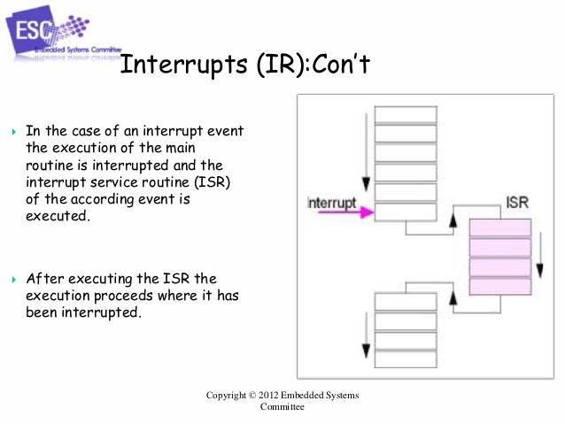
INTERRUPT IN ARDUINO:
Hardware interrupt can be triggered by a state change in any one of the digital pins that is either from HIGH to LOW or vise versa(e.g. pressing of push button).
Most of the Arduino’s have two hardware interrupts (referred to as "interrupt0" and "interrupt1") hard-wired to digital I/O pins 2 and 3, respectively.
You can define a routine using a special function called as “Interrupt Service Routine” (usually known as ISR)
It is possible to have that function executed automatically, each time an event happens on an input pin.

Slide 39
attachInterrupt Statement Syntax:
attachInterrupt(pin, ISR, mode)
argument pin: The pin number
argument ISR: The ISR to call when the interrupt occurs.This function must take no parameters and return nothing. This function is sometimes referred to as an interrupt service routine.
argument mode: defines when the interrupt should be triggered.
The following four constants are predefined as valid values −
LOW to trigger the interrupt whenever the pin is low.
CHANGE to trigger the interrupt whenever the pin changes value.
FALLING whenever the pin goes from high to low
RISING whenever the pin goes from low to high

Slide 40
Interrupt Example
Change the state of LED whenever push button is pressed
https://www.tinkercad.com/things/fUMaXcknuTl

